Slide 1
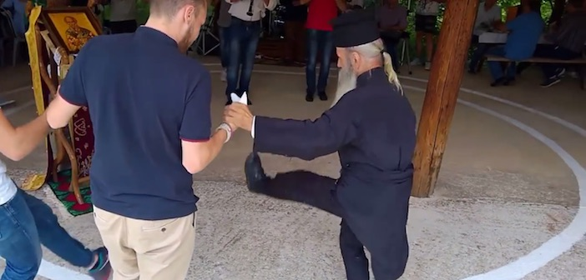
A Greek Orthodox priest, reported to e 72 years old, dancing a traditional Tsamiko dance in a village near Ioannina
P 1 A Greek Orthodox priest, reported to be 72 years old, dancing a traditional Tsamiko dance in a village near Ioannina

Slide 2
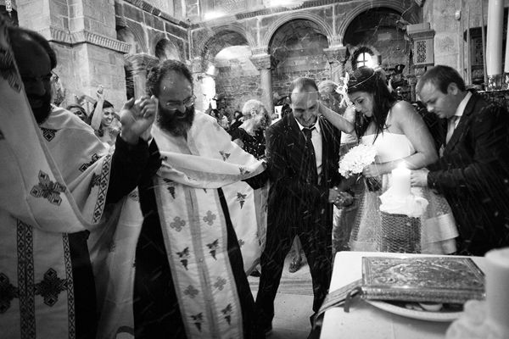
P2 Ritual Ring Dance during the office of Wedding in a Greek Orthodox Church

Slide 3
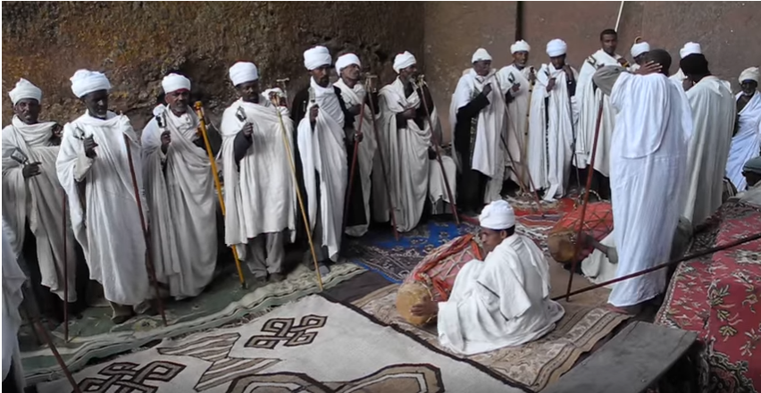
P3 Ethiopian priests' religious ceremony and dance at thr rock-hewn church Bet Maryam, Lalibela.Ceremony on the day of the Holy Cross.

Slide 4
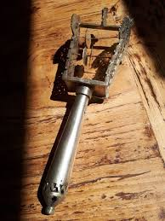
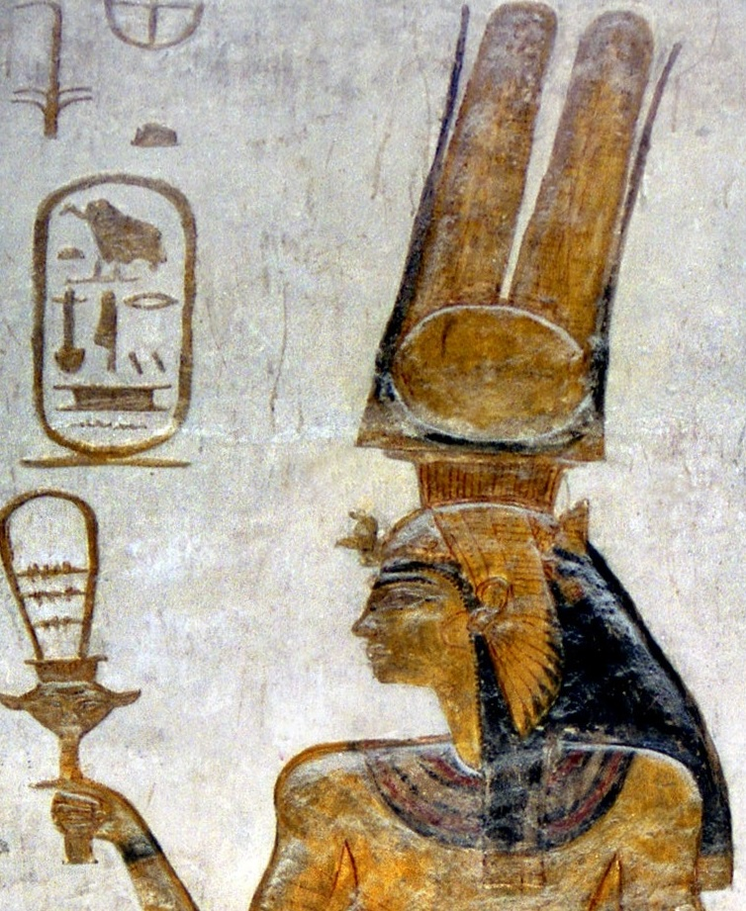
P4 Ethiopian orthodox church: old silver Sistrum-tsenasil liturgic musical instrument (and a representation of Nefertiti holding sistrum)

Slide 5
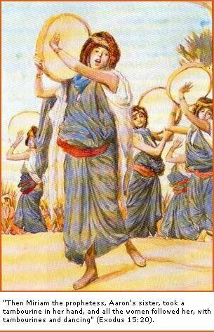
P5 The timbrel or tabret (also known as the tof of the ancient Hebrews, the deff of Islam, the adufe of the Moors of Spain) was the principal percussion instrument of the ancient Israelites. It resembles the modern tambourine.

Slide 6
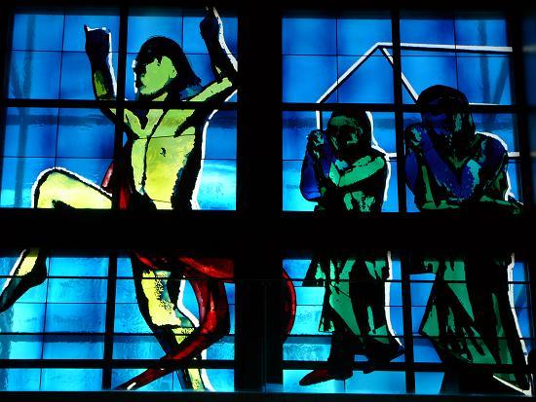
PIC 6 Stained glass of Notre Dame of the Ark of Alliance, church of Paris 15th,(cardboard is of Martial Raysse)

Slide 7
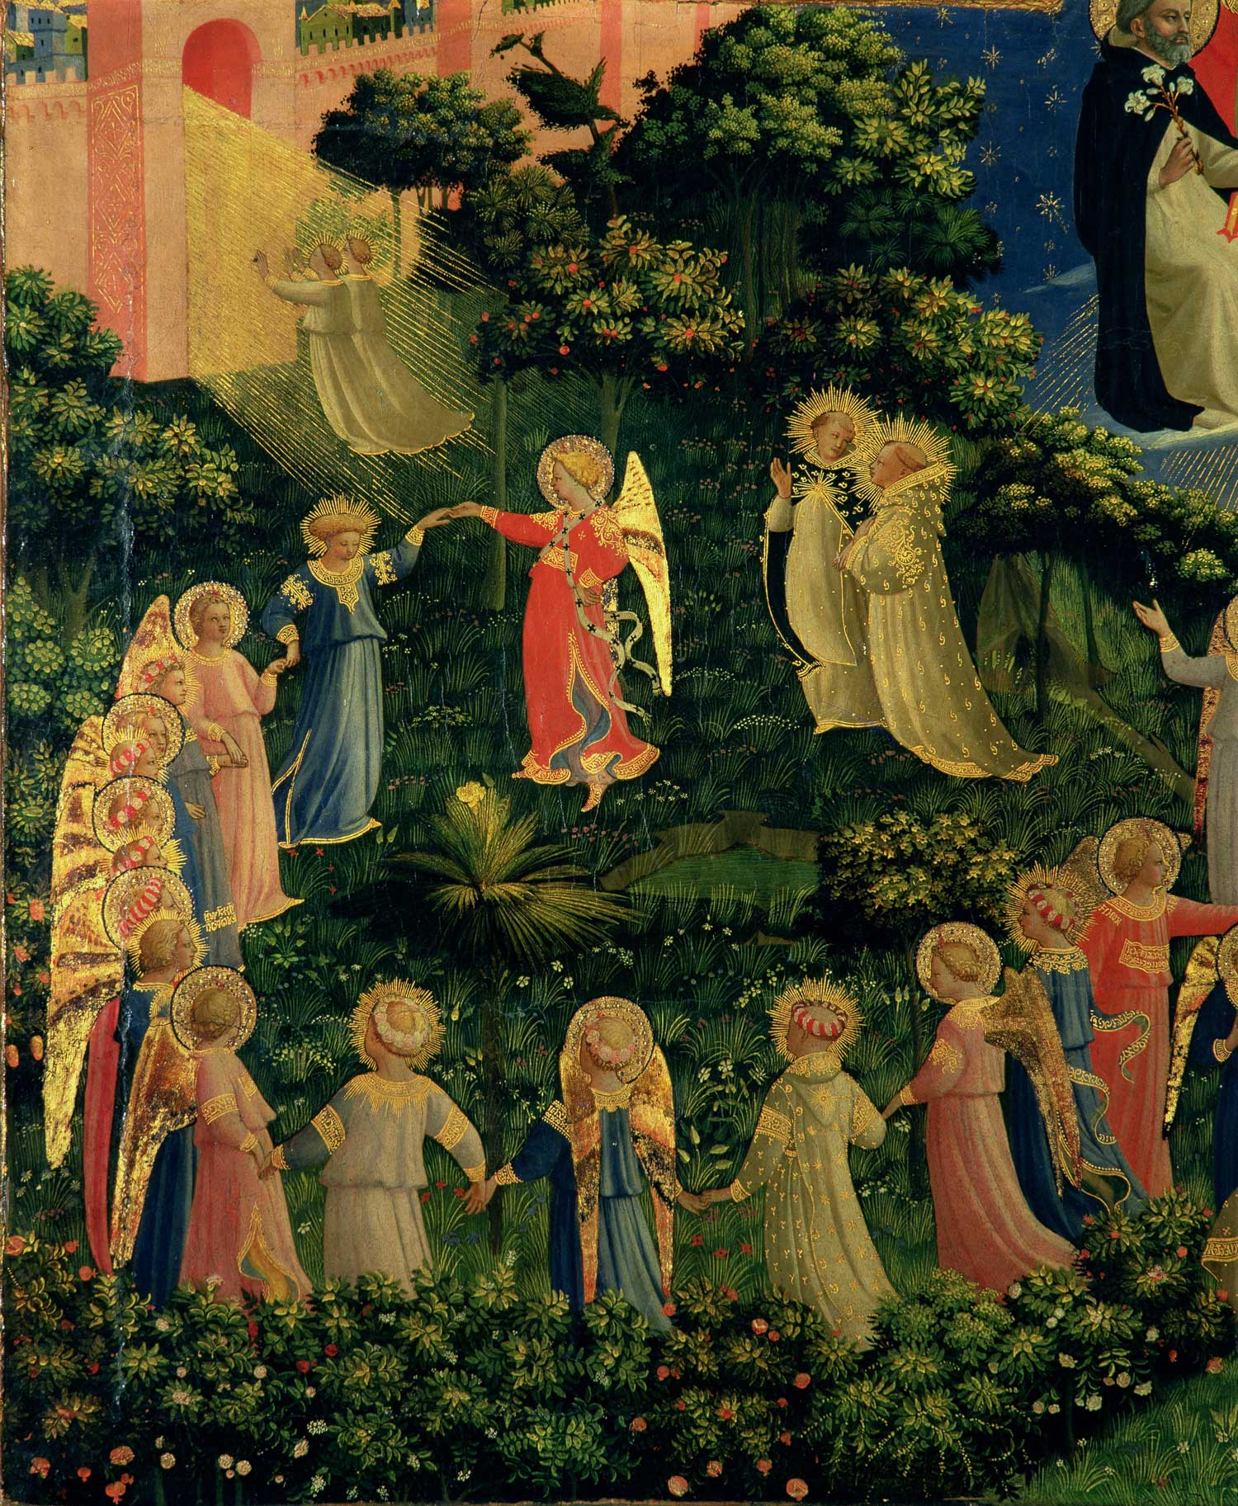
PIC7 : The Last Judgment (detail: “Paradise”) by Fra Angelico,
(15th Century)

Slide 8
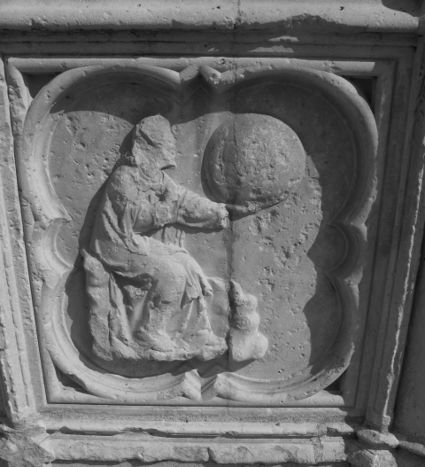
PIC 8
West Portal of the Cathedral of Auxerre

Slide 9
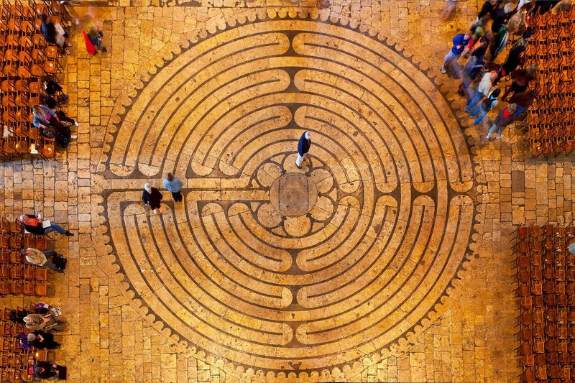
PIC 9 Medieval clergy played ball in labyrinths, such as the one at Chartres Cathedral.

Slide 10
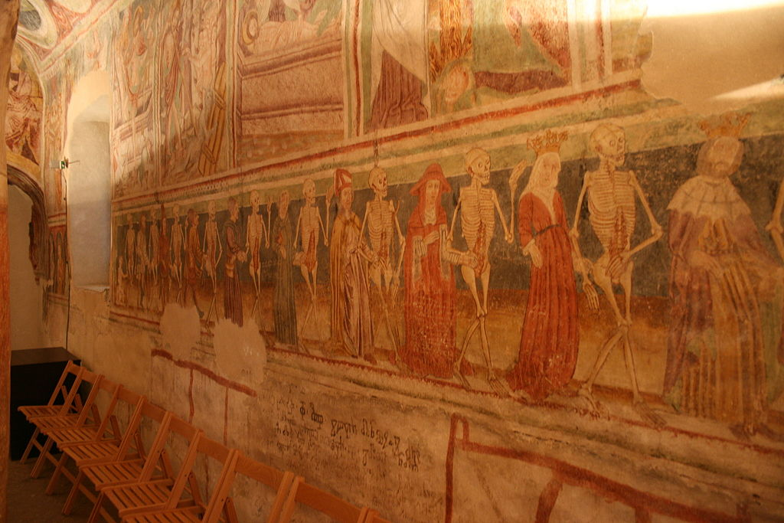
in St. icholas' Church, Tallinn
P10a : The famous Danse Macabre in Hrastovlje (Slovenia) in the Holy Trinity Church

Slide 11
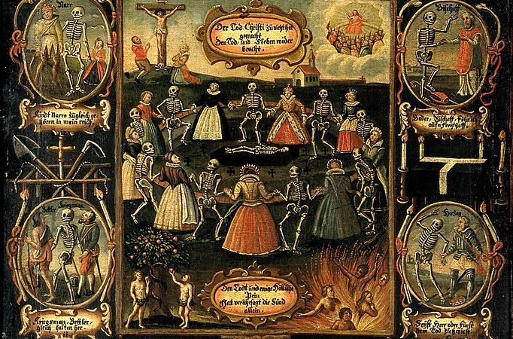
P10b A German painting of the Danse Macabre from the 18th century. Nine women of different social rank from empress to fool dance with the dead. The entire economy of salvation is depicted, from the Fall, through the crucifixion, to Heaven and Hell. Twelve more traditional Dance Macabre figures, from pope and emperor down to fool, surround the central image. (Credit: Wikimedia Commons.)

Slide 12
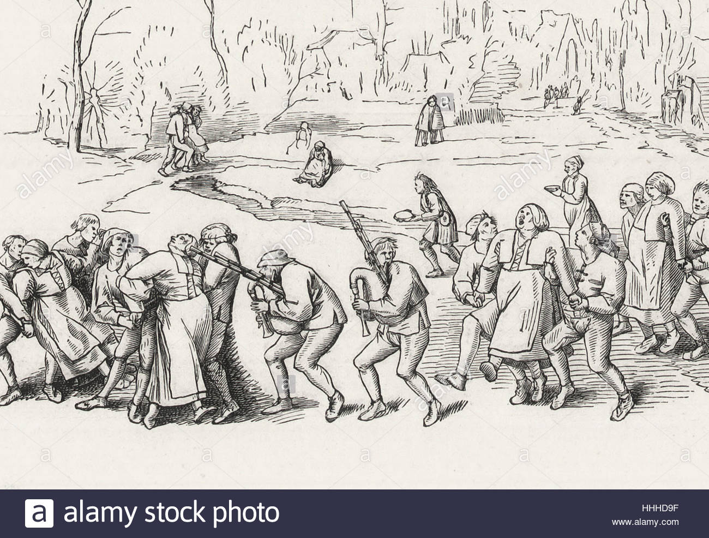
P11 St Vitus Dance

Slide 13
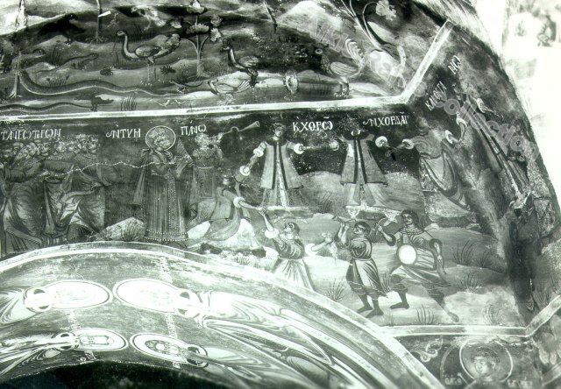
P12a Virgins, older men and younger, with drums and dances... 1600 approx. Painting, mural. Greece, Mount Athos, Monastery of Dochiarion.

Slide 14
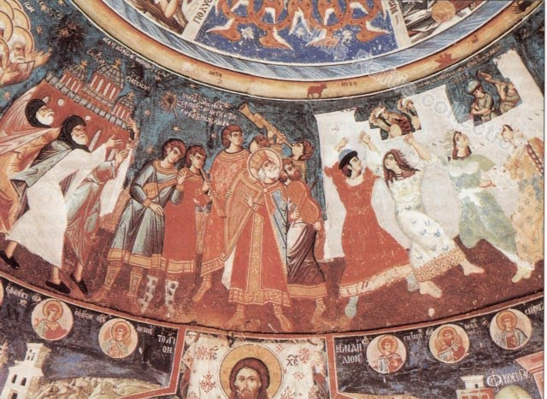
P12B Four young women in a vigorous dance. Scene from "Praise ye the Lord. 1715.Painting, mural, fresco. Greece, Mount Athos, Greatest Lavra Monastery, Koukouzelissa Chapel .

Slide 15
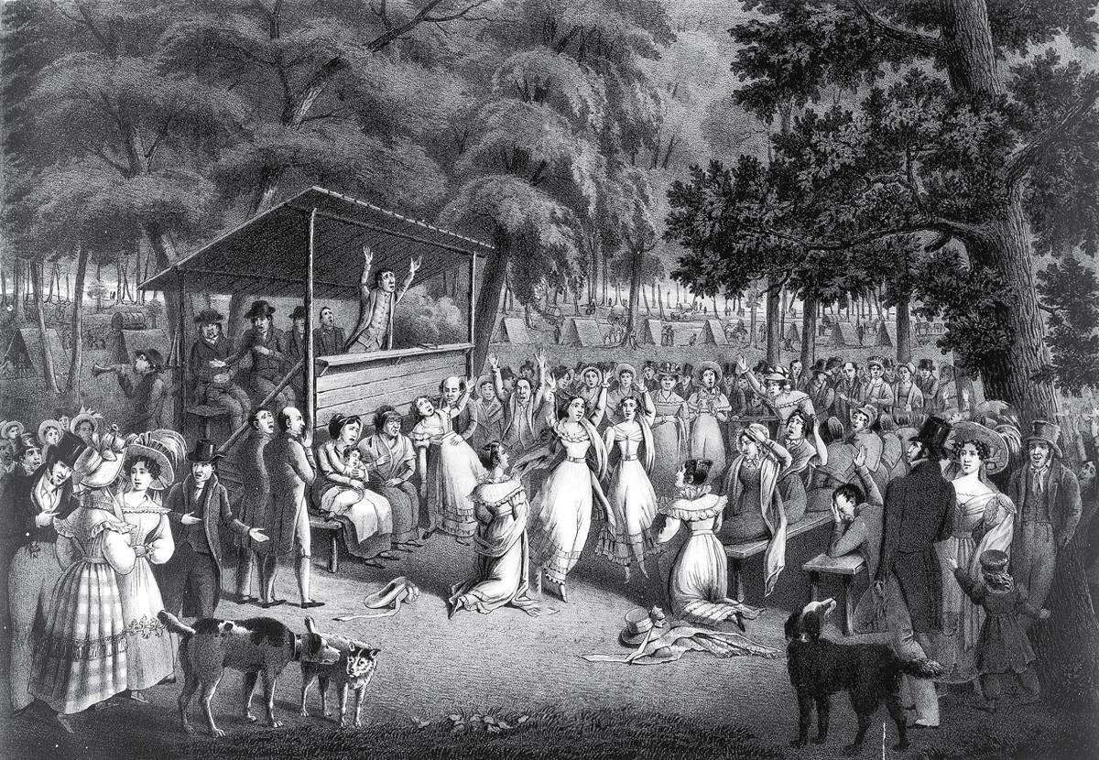
P13 : 1801 Cane Ridge Revival

Slide 16
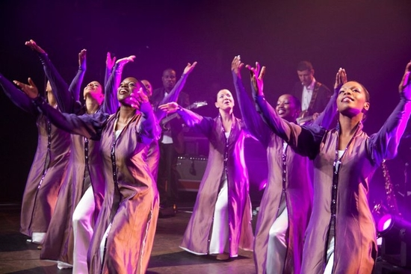
P14 : Total Praise Danse (Centre of christian Revival ). Directed par Virginie NFA, ...

Slide 17
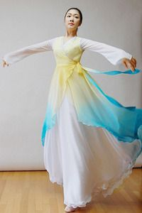
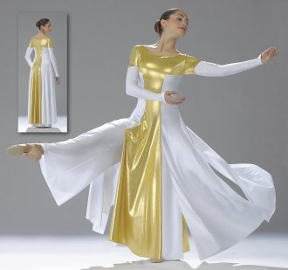
P15 Dance Fashion (Praise dance wear, Liturgical dance wear, worship dance attire )

Slide 18
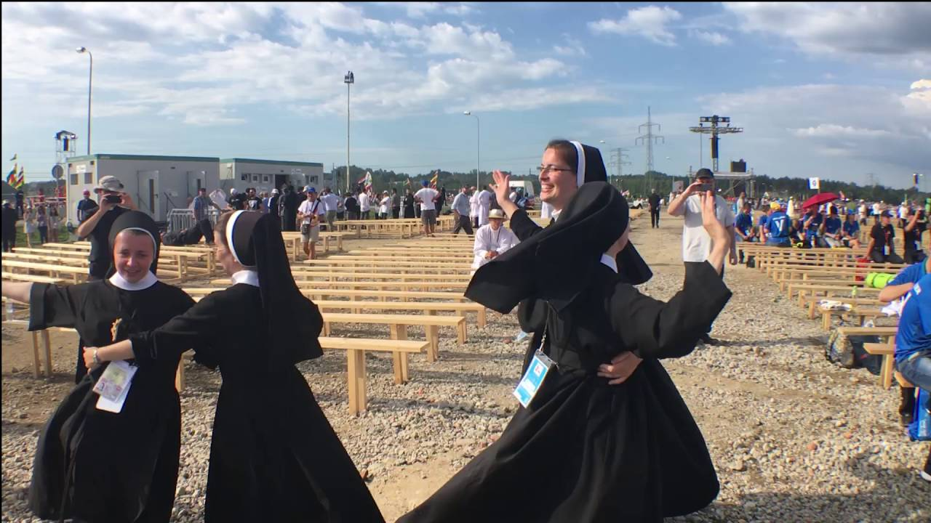
P16 :Before the final Mass of World Youth Day 2016 in Krakow, Poland; these Polish sisters filled with the Joy of the Gospel are enjoying their time by dancing to the music.

Slide 19
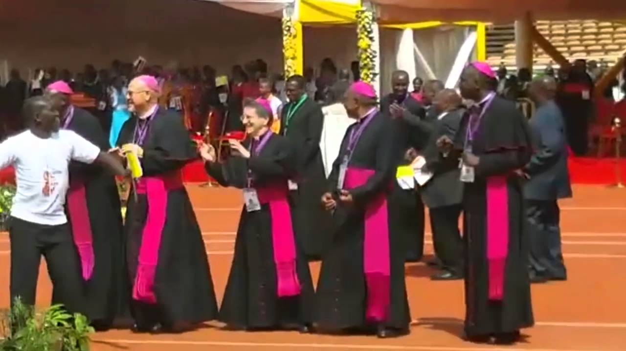
P17a Catholic Archbishops in Africa Dance to Kanda bongoman'Song

Slide 20
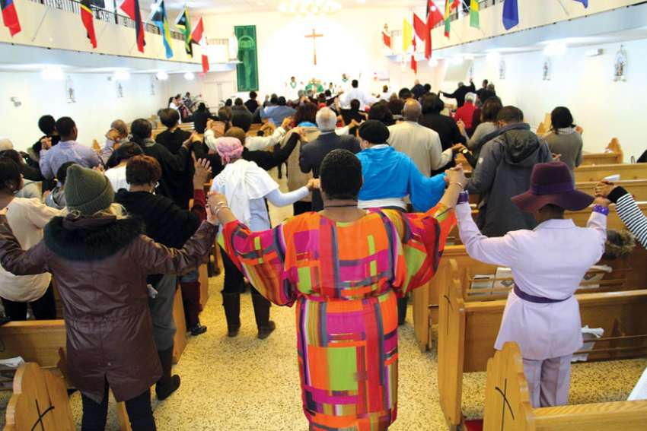
P17b The pews and the centre aisle are filled at Our Lady of Good Counsel, the Archdiocese of Toronto’s Caribbean parish. Bodies moving, hands clapping and voices rising in worship is the norm at the parish.

Slide 21
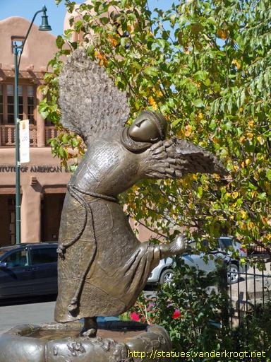
P18 Bronze statue of St. Francis with wings instead of arms, and dancing in a waterbasin. All over the body are prayers written.

